Slide 1
Extreme Gradient Boost
Abhijit Ramesh Patil

Slide 2
What is XG Boost algorithm ?
XG boost stands for Extreme Gradient Boosting which is scalable, distributed machine learning library.
XG Boost falls under category of Boosting techniques in ensemble learning.
In Boosting technique the errors made by previous models are tried to be corrected by succeeding models by adding some weights to the model.
Why to use XG Boost?
1.Execution speed
2.Model performance
(C++ is the language in which the library is written)

Slide 3
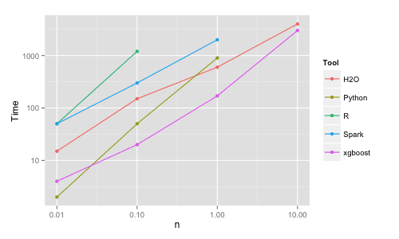

Slide 4
What are the properties of XG Boost ?
Can be run on both single and distributed system(Hadoop, spark)
It is used in supervise learning (Regression and Classification problem)
Support parallel processing
Cache optimization
Efficient memory management for large datasets exceeding RAM.
Has variety of regularizations which helps in reducing overfitting
Auto Tree pruning – Decision tree will not grow further after certain limits internally
Can handle missing values
Has inbuilt Cross validation

